Slide 1
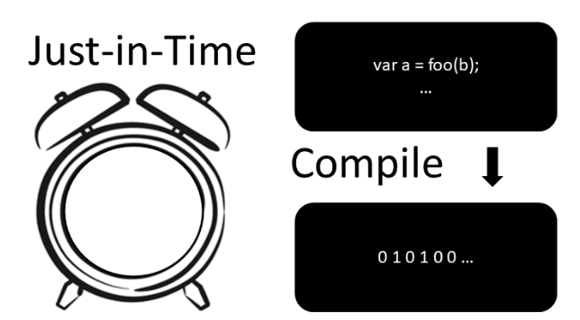
Workshop
Made by Jorge and Thijs

